Slide 1
Interpreting pie charts
Graphical representations of data

Slide 2
how to use Oak lessons

Slide 3
I can interpret pie charts.

Slide 4
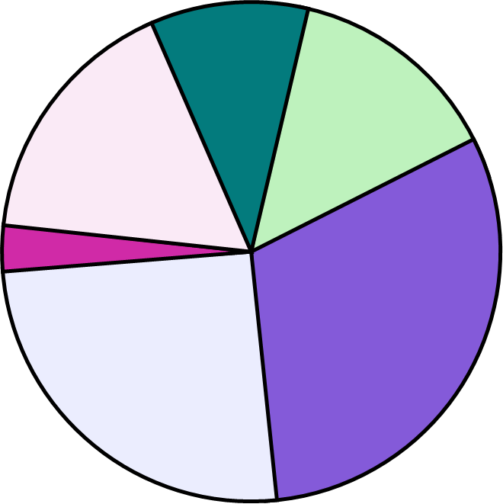
A pie chart (pie graph) is a circular graph where sectors represent different groups proportionally.
The frequency is the number of times an event occurs; or the number of individuals (people, animals etc.) with some specific property.
A sector is the region formed between two radii and their connecting arc.
Proportion is a part to whole (sometimes part to part) comparison. If two things are proportional then the ratio of part to whole is maintained and the multiplicative relationship between parts is also maintained.
Degrees are the most common unit of measurement for angle. One whole turn is equal to 360 degrees, written 360°.

Slide 5

Interpreting pie charts
Calculating frequencies from the size of a sector
Comparing pie charts

Slide 6
Calculating frequencies from the size of a sector
The table below shows all the angles, but not all the frequencies. Show a method to find these missing frequencies.
teachers from parts of the UK
location | frequency | angles
England |  | 176°
N. Ireland |  | 20°
Scotland |  | 104°
Wales |  | 60°
total |  | 360°
If you don’t know one of the following:
the total frequency
any of the other frequencies
Then you cannot calculate anything new.
15
But the moment you know one frequency (or the total frequency), then you can calculate all the rest.
Unknown multiplier

Slide 7
Calculating frequencies from the size of a sector
The table below shows all the angles, but not all the frequencies. Show a method to find these missing frequencies.
teachers from parts of the UK
location | frequency | angles
England |  | 176
N. Ireland |  | 20
Scotland |  | 104
Wales |  | 60
total |  | 360°
Step 1 is to find the multiplier.
You can multiply the frequency by the multiplier to get the angle.
15
So, you can also divide the angle by the frequency to get the multiplier.
× 4
60 ÷ 15 = 4
Unknown multiplier

Slide 8
Calculating frequencies from the size of a sector
÷ 4
teachers from parts of the UK
location | frequency | angles
England |  | 176
N. Ireland |  | 20
Scotland |  | 104
Wales |  | 60
total |  | 360°
Step 2 is to use the multiplier to find the frequencies.
44
176 ÷ 4 =
5
26
You can divide an angle by the multiplier in order to calculate the corresponding frequency.
15
× 4

Slide 9
Calculating frequencies from the size of a sector
teachers from parts of the UK
location | frequency | angles
England |  | 176
N. Ireland |  | 20
Scotland |  | 104
Wales |  | 60
total |  | 360°
We can check if the values are correct by seeing if the total frequency is the same as:
44
5
26
360 ÷ the multiplier
15
Total frequency = 44 + 5 + 26 + 15 = 90
90
360 ÷ the multiplier = 360 ÷ 4 = 90 ✔
× 4

Slide 10


Calculating frequencies from the size of a sector
What calculation finds the multiplier for this pie chart table?
rainfall (days) | frequency | angles
dry | 5 | 60°
light showers |  | 168°
rain |  | 120°
heavy rain |  | 12°
total |  | 360°
a
360 ÷ 5 = 72
b
60 × 5 = 300
c
60 ÷ 5 = 12
d
4 ÷ 5 = 0.8
× 12

Slide 11
Calculating frequencies from the size of a sector
What was the frequency of days with “rain”?
÷ 12
rainfall (days) | frequency | angles
dry | 5 | 60°
light showers |  | 168°
rain |  | 120°
heavy rain |  | 12°
total |  | 360°
Rain had an angle of 120°.
120 ÷ the multiplier =
120 ÷ 12 = 10
10
× 12

Slide 12

Calculating frequencies from the size of a sector
You can also calculate frequencies by measuring the angles of a pie chart using a protractor.
A total of 72 people were asked what their preferred shopping location was.
in-town
out-of-town
location | frequency | angles
in-town
out-of-town
online
total
online
72
360°

Slide 13
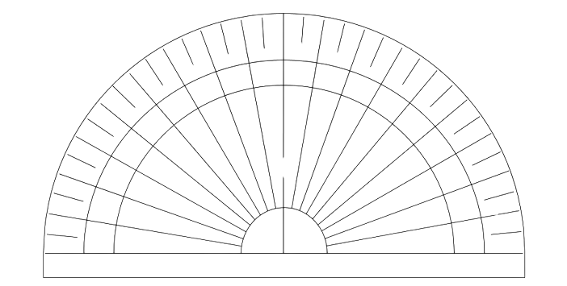
Calculating frequencies from the size of a sector
Using your protractor, measure the size of one angle at a time.
location | frequency | angles
in-town
out-of-town
online
total
75°
90°
100°
80°
70°
110°
60°
120°
50°
130°
40°
140°
30°
150°
in-town
out-of-town
72
360°
20°
160°
10°
170°
0°
180°
Make sure to line up the bottom centre of your protractor with the centre of your circle, and the 0° with one of the radii of the pie chart.
online

Slide 14
Calculating frequencies from the size of a sector
Using your protractor, measure the size of one angle at a time.
location | frequency | angles
in-town
out-of-town
online
total
75°
125°
160°
80°
70°
90°
100°
110°
120°
60°
out-of-town
130°
in-town
50°
72
360°
40°
140°
30°
150°
80°
70°
90°
100°
110°
160°
60°
20°
120°
Remember to rotate your protractor to align the 0° with a different line each time you measure an angle.
50°
10°
130°
170°
40°
140°
0°
150°
180°
30°
online
20°
160°
10°
170°
0°
180°

Slide 15
Calculating frequencies from the size of a sector
When you have found all the angles, the process is the same as before.
÷ 5
location | frequency | angles
in-town
out-of-town
online
total
Step 1: Calculate the multiplier.
75 ÷ 5 =
75°
15
Step 2: Use the multiplier to divide each of the angles to calculate the frequency.
25
125°
32
160°
72
360°
Step 3: Check your answer by adding up the frequencies and seeing if the total is equal to the total frequency.
× 5
15 + 25 + 32 =
72

Slide 16

Calculating frequencies from the size of a sector
What angle is the protractor measuring for strong breeze?
windspeed | frequency | angles
no wind |  | 48°
breeze |  | 184°
strong breeze | 15
gale
total |  | 360°
breeze
90°
100°
80°
no wind
70°
110°
120°
60°
120°
gale
130°
50°
40°
140°
30°
150°
strong breeze
20°
160°
10°
170°
0°
180°

Slide 17
Calculating frequencies from the size of a sector
÷ 8
windspeed | frequency | angles
no wind |  | 48°
breeze |  | 184°
strong breeze | 15
gale
total |  | 360°
Calculate the multiplier that multiplies the frequency to get the angle.
120°
120 ÷ 15 = 8
× 8

Slide 18
Calculating frequencies from the size of a sector
÷ 8
windspeed | frequency | angles
no wind |  | 48°
breeze |  | 184°
strong breeze | 15
gale
total |  | 360°
Calculate the missing angle for gale.
8
48 + 184 + 120 + = 360
120°
8°
× 8

Slide 19
Calculating frequencies from the size of a sector
subject | frequency | angles
maths |  | 152°
english |  | 60°
science |  | 100°
other |  | 48°
total |  | 360°
1) A group of students were asked what their favourite subject was. 25 students voted for “science”.
a) Calculate the multiplier for this set of data.
b) Calculate all other frequencies by dividing using this multiplier.
c) Calculate the total number of students who were asked.
× .

Slide 20
Calculating frequencies from the size of a sector
activity | frequency | angles
cake sale |  | 63°
concert | 39 | 117°
charity race |  | 150°
face painting |  | 30°
 |  | 360°
2) Oakfield Academy are organising a fair to raise money to improve environmental efficiency of their school.
The data shows votes of students for what they will do during the fair.
Calculate all missing frequencies.
× .

Slide 21
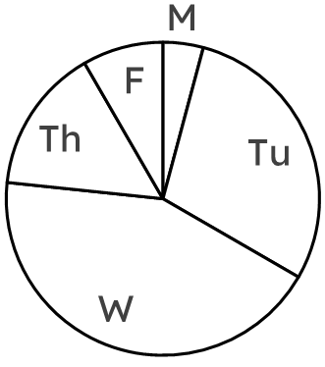
Calculating frequencies from the size of a sector
day | freq. | angles
Monday | 5
Tuesday
Wednesday |  | 156°
Thursday |  | 54°
Friday
3) The pie chart shows the suggested days of the week the fair could be run on. Complete the table by:
a) measuring all missing angles,
b) calculating all missing frequencies.

Slide 22
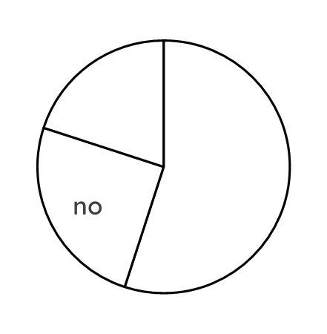
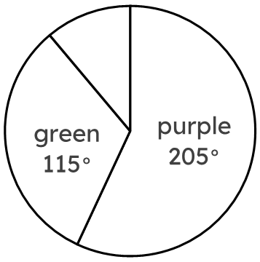
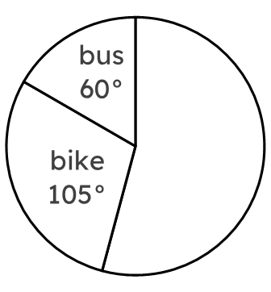
Calculating frequencies from the size of a sector
4) Fill in all missing information for each table and pie chart.
colour | freq. | angles
purple
green
blue | 8
total
vehicle | freq. | angles
car | 13
bike
bus
total
vote | freq. | angles
yes | 165
no | 75
undecided
total

Slide 23
Calculating frequencies from the size of a sector
subject | frequency | angles
maths | 38 | 152°
English | 15 | 60°
science | 25 | 100°
other | 12 | 48°
total | 90 | 360°
1) A group of students were asked what their favourite subject was. 25 students voted for “science”.
a) Calculate the multiplier for this set of data.
b) Calculate all other frequencies by dividing using this multiplier.
c) Calculate the total number of students who were asked.
4
× .

Slide 24
Calculating frequencies from the size of a sector
activity | frequency | angles
cake sale | 21 | 63°
concert | 39 | 117°
charity race | 50 | 150°
face painting | 10 | 30°
 | 120 | 360°
2) Oakfield Academy are organising a fair to raise money to improve environmental efficiency of their school.
The data shows votes of students for what they will do during the fair.
Calculate all missing frequencies.
3
× .

Slide 25
Calculating frequencies from the size of a sector
day | freq. | angles
Monday | 5 | 15°
Tuesday | 35 | 105°
Wednesday | 52 | 156°
Thursday | 18 | 54°
Friday | 10 | 30°
3) The pie chart shows the suggested days of the week the fair could be run on. Complete the table by:
a) measuring all missing angles,
b) calculating all missing frequencies.

Slide 26
Calculating frequencies from the size of a sector
4) Fill in all missing information for each table.
colour | freq. | angles
purple | 41 | 205°
green | 23 | 115°
blue | 8 | 40°
total | 72 | 360°
vehicle | freq. | angles
car | 13 | 195°
bike | 7 | 105°
bus | 4 | 60°
total | 24 | 360°
vote | freq. | angles
yes | 165 | 198°
no | 75 | 90°
undecided | 60 | 72°
total | 300 | 360°

Slide 27
Interpreting pie charts
Calculating frequencies from the size of a sector
Comparing pie charts

Slide 28
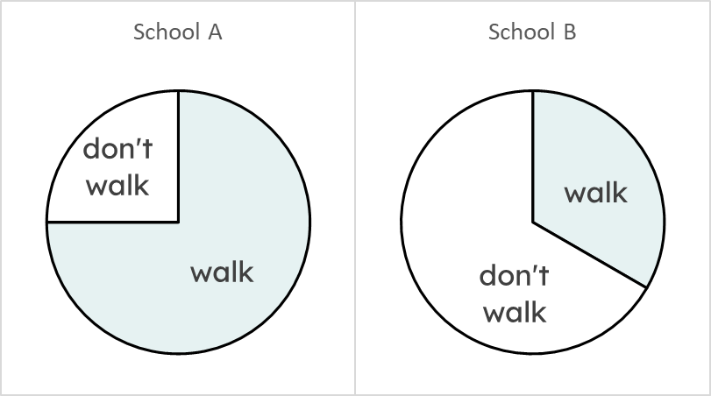
Comparing pie charts
Two schools were asked how many of their students walk to school.
Here are the results represented as pie charts. In which school did more students walk to school?
Whilst a greater proportion of students in School A walked, compared to School B,
more students in School B walked because School B had significantly more students.
50
200
400
The size of School B was more significant than the lower proportion of students who walked represented.
150

Slide 29
Comparing pie charts
If two pie charts both have a sector with the same angle, then they always represent the same frequency.
Because the angle doesn’t represent the frequency
Because one pie chart may represent a larger dataset

Slide 30
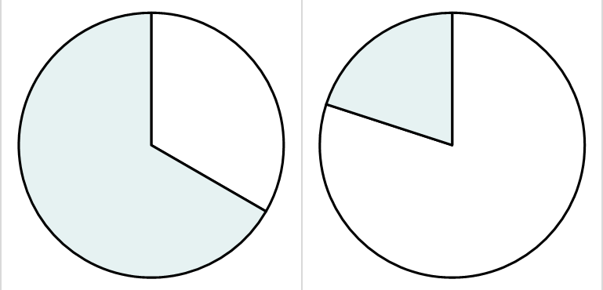
Comparing pie charts
Students who walked to school and students who didn’t walk to school were asked at the school gates:
a
b
more
than
5 km
72°
5 km or less
120°
“Do you live more than 5 km away from school?”
more
than
5 km
240°
5 km or less
288°

Slide 31
Comparing pie charts
Match the description to the correct pie chart:
a
b
more
than
5 km
72°
5 km or less
120°
c
Students who walked to the school
more
than
5 km
240°
5 km or less
288°
d
Students who didn’t walk to school
d
Students who didn’t walk to school
c
Students who walked to the school

Slide 32
Comparing pie charts
Didn’t walk to school
Walked to school
Sector x and sector y both represent the same number of students.
Which pie chart represents a larger number of students: those that didn’t walk to school, or those that did?
sector x
sector y
more
than
5 km
72°
5 km or less
120°
more
than
5 km
240°
5 km or less
288°

Slide 33
Comparing pie charts
Didn’t walk to school
Walked to school
Let’s say both sector x and sector y represent 10 students.
sector x
sector y
10 students
more
than
5 km
72°
5 km or less
120°
10
students
Those 10 students represent a large proportion of the total pie chart.
more
than
5 km
240°
5 km or less
288°
This means there are fewer other students represented by this part of the pie chart.
There’s a greater proportion leftover here from the 10 students, and so the “walked to school” pie chart represents a larger total frequency.

Slide 34
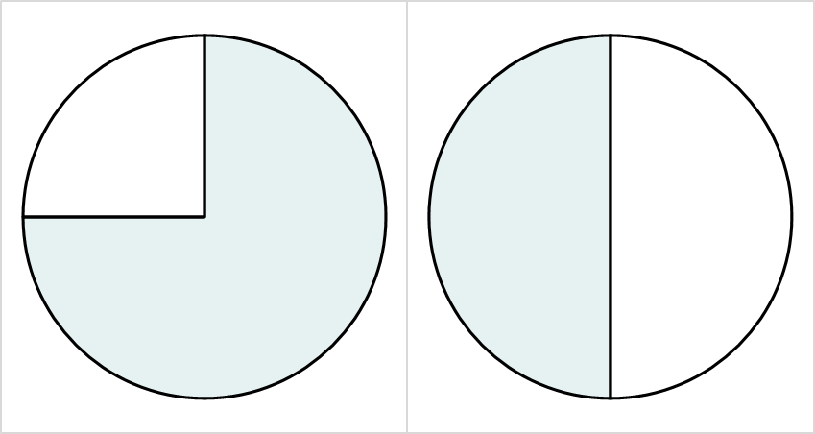
Comparing pie charts
1) A headteacher is comparing the exam results of two classes.
Class R
Class P
The headteacher says “more students passed the exam in Class R”.
The headteacher may be incorrect. Can you explain why?
fail
pass
fail
pass

Slide 35
Comparing pie charts
2)
In both classes, 15 students passed the exam.
Complete the ratio tables below to work out which class had more students.
Class R
Class P
fail
pass
fail
pass
Class R
Class P
pass | fail | total
 |  | 360°
15
pass | fail | total
180° | 180° | 360°
15

Slide 36
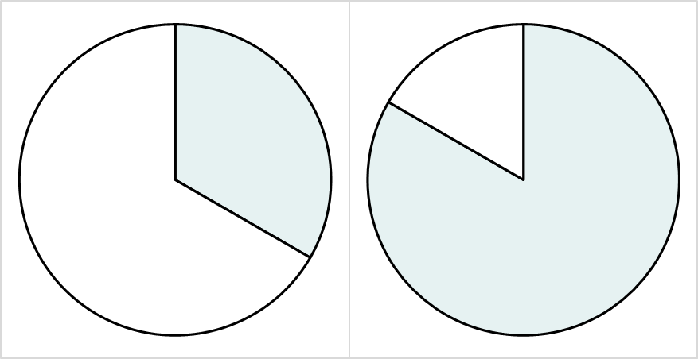
Comparing pie charts
3) People in Leeds city centre were asked whether they support Leeds United, and whether they would watch Leeds United’s next football match.
Two pie charts were drawn, one to show supporters, and one to show non-supporters.
a
b
won’t
watch
watch
won’t
watch
watch
Which of the two pie charts represents the group of people who support Leeds United? Explain how you know.

Slide 37
Comparing pie charts
a
b
group a
won’t
watch
watch | won’t watch | total
 |  | 360°
80
watch
won’t
watch
240°
watch
300°
group b
watch | won’t watch | total
 |  | 360°
 | 80
4) The minor sector of each group both represent 80 people.
In which group were more people interviewed, and by how many people?
Fill in the ratio tables to help you.

Slide 38
Comparing pie charts
1) A headteacher is comparing the exam results of two classes.
Class R
Class P
The headteacher says “more students passed the exam in Class R”.
The headteacher may be incorrect. Can you explain why?
fail
pass
fail
pass

Slide 39
Comparing pie charts
1) A headteacher is comparing the exam results of two classes.
Class R
Class P
A higher proportion of students in Class R (three-quarters) passed the exam than Class P (half).
However, Class R could be a lot smaller than class P so that the three-quarters of a small class is smaller than half of the bigger Class P.
fail
pass
fail
pass
Class size of 12
Class size of 30
Three-quarters of 12 is 8.
Half of 30 is 15.

Slide 40
Comparing pie charts
2)
In both classes, 15 students passed the exam.
Complete the ratio tables below to work out which class had more students.
Class R
Class P
fail
pass
fail
pass
Class P had 10 more students.
Class R
Class P
pass | fail | total
270 | 90 | 360°
15 | 5 | 20
pass | fail | total
180° | 180° | 360°
15 | 15 | 30

Slide 41
Comparing pie charts
3) People in Leeds city centre were asked whether they support Leeds United, and whether they would watch Leeds United’s next football match.
Two pie charts were drawn, one to show supporters, and one to show non-supporters.
a
b
won’t
watch
watch
won’t
watch
watch
Which of the two pie charts represents the group of people who support Leeds United? Explain how you know.

Slide 42
Comparing pie charts
3)
Pie chart b is more likely to represent people who support Leeds United, as they are more likely to watch their matches than someone who doesn’t support the team.
a
b
won’t
watch
watch
won’t
watch
watch

Slide 43
Comparing pie charts
a
b
group a
won’t
watch
60°
watch | won’t watch | total
120° | 240° | 360°
80 | 160 | 240
watch
120°
won’t
watch
240°
watch
300°
group b
watch | won’t watch | total
300° | 60° | 360°
400 | 80 | 480
4) The minor sector of each group both represent 80 people.
In which group were more people interviewed, and by how many people?
Fill in the ratio tables to help.
480 - 240 = 240 more people were interviewed in group b.

Slide 44
Interpreting pie charts
Calculating the multiplier is important when dividing the angle of a sector of a pie chart in order to find the frequency that sector represents.
A protractor can be used to find the sector of an angle so that the frequency can be found.
Even if two pie charts have a sector of equal angle, they may represent different frequencies as each pie chart may have a different total.

Slide 45

© Oak National Academy 2023.
Produced in partnership with Mathematics in Education and Industry.
Licensed on the Open Government Licence v3.0, except where otherwise stated. See Oak terms and conditions.

